Slide 1

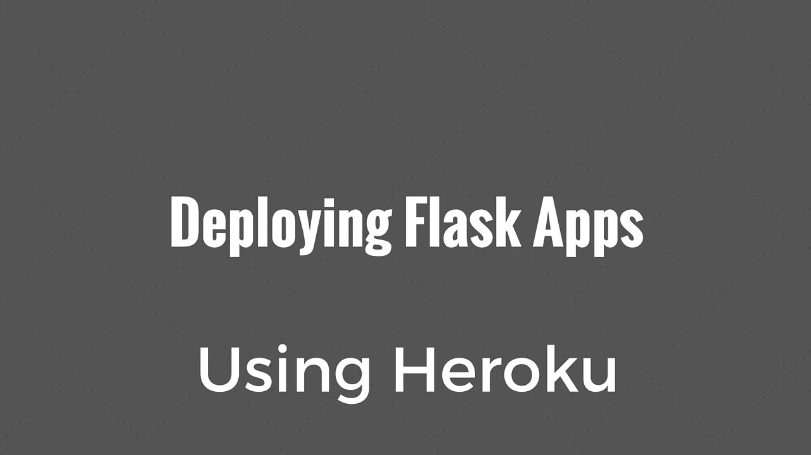
Machine Learning Model Deployment
Copyright © www.ITbodhi.com

Slide 2
Steps:
Create and Pickle a Model Using Titanic Data
Create Flask App
Test Flask App in Production (optional)
Create GitHub Repository (optional)
Deploy to Heroku
Test Working App
Machine Learning Model Deployment
Copyright © www.ITbodhi.com

Slide 3
Machine Learning Model Deployment
Creating and Training a Model
Titanic Data set
Copyright © www.ITbodhi.com

Slide 4
#serializing our model to a file called model.pkl
import pickle
pickle.dump(dt_clf_gini, open(".../Logistic_Regression_model.pkl","wb"))
The pickle module implements a fundamental, but powerful algorithm for serializing and de-serializing a Python object structure. “Pickling” is the process whereby a Python object hierarchy is converted into a byte stream, and “unpickling” is the inverse operation, whereby a byte stream is converted back into an object hierarchy. Pickling (and unpickling) is alternatively known as “serialization”, “marshalling,” 1 or “flattening”, however, to avoid confusion, the terms used here are “pickling” and “unpickling”.
As a data scientist, you will use sets of data in the form of dictionaries, DataFrames, or any other data type. When working with those, you might want to save them to a file, so you can use them later on or send them to someone else. This is what Python's pickle module is for: it serializes objects so they can be saved to a file, and loaded in a program again later on.
Machine Learning Model Deployment
Copyright © www.ITbodhi.com

Slide 5

Creating a Simple Web Application using Flask
Flask is a python based microframework used for developing small scale websites.
It can create a REST API that allows you to send data, and receive a prediction as a response.
Similar to what Django REST framework .
Machine Learning Model Deployment
Copyright © www.ITbodhi.com

Slide 6
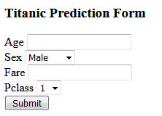
Creating a Simple HTML Form for WebApp
Index.html
Machine Learning Model Deployment
Copyright © www.ITbodhi.com

Slide 7
Installing Flask
!pip install flask
Create a project directory i.e flask-app
Put Logistic_Regression_model.pkl in project directory flask-app
mkdir templates under directory flask-app
Put index.html in templates directory
Machine Learning Model Deployment
Copyright © www.ITbodhi.com

Slide 8
Create Logistic_Regression_model.py file and put under Titanic_Flask_Prediction directory
import os
import numpy as np
import flask
import pickle
from flask import Flask, render_template, request
#creating instance of the class
app=Flask(__name__)
#to tell flask what url should trigger the function index()
@app.route('/')
@app.route('/index')
def index():
return flask.render_template('index.html')
if __name__ == '__main__':
app.run(port = 5000, debug=True)
Machine Learning Model Deployment
app=Flask(__name__) create an instance of flask.
@app.route('/') is used to tell flask what url should trigger the function index()
In the function index we use render_template('index.html') to display the script index.html in the browser.
Copyright © www.ITbodhi.com

Slide 9
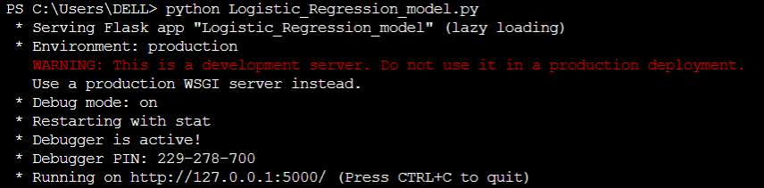
Now run the application from jupyter terminal
python Logistic_Regression_model.py
This should run the application and launch a simple server. Open http://127.0.0.1:5000/ to see the html form.
Machine Learning Model Deployment
Copyright © www.ITbodhi.com

Slide 10
Putting the Prediction part in file Logistic_Regression_model.py
#prediction function
def ValuePredictor(to_predict_list):
to_predict = np.array(to_predict_list).reshape(1,4)
loaded_model = pickle.load(open("Logistic_Regression_model.pkl","rb"))
result = loaded_model.predict(to_predict)
return result[0]
@app.route('/result',methods = ['POST'])
def result():
if request.method == 'POST':
to_predict_list = request.form.to_dict()
to_predict_list=list(to_predict_list.values())
to_predict_list = list(map(int, to_predict_list))
result = ValuePredictor(to_predict_list)
if int(result)==1:
prediction='Pessenger survived'
else:
prediction='Pessenger NOT survived'
return render_template("result.html",prediction=prediction).
Machine Learning Model Deployment
Here after the form is submitted, the form values are stored in variable to_predict_list in the form of dictionary.
We convert it into a list of the dictionary’s values and pass it as an argument to ValuePredictor() function.
In this function, we load the Logistic_Regression_model.pkl file and predict the new values and return the result.
This result/prediction is then passed as an argument to the template engine with the html page to be displayed.
Copyright © www.ITbodhi.com

Slide 11
Create the following result.html file and add it to templates directory.
<!doctype html>
<html>
<body>
<h1> {{ prediction }}</h1>
</body>
</html>
Run the application again
python Logistic_Regression_model.py
It should predict the income after submitting the form.
Copyright © www.ITbodhi.com

Slide 12
This is how our project layout looks like
Machine Learning Model Deployment
/flask-app
├── templates │ └── index.html
│ └── result.html ├── Logistic_Regression_model.py
├── Logistic_Regression_model.pkl
Copyright © www.ITbodhi.com

Slide 13

Successfully created the Webapp
Now it’s time to use heroku to deploy it
Machine Learning Model Deployment
Heroku is a platform as a service (PaaS) that enables developers to build, run, and operate applications entirely in the cloud.
Copyright © www.ITbodhi.com

Slide 14
Install gunicorn
!pip install gunicorn
Gunicorn handles requests and takes care of complicated things like threading very easily in real production.
Machine Learning Model Deployment
Copyright © www.ITbodhi.com

Slide 15
Three common building blocks when deploying a Python web application to production are:
A web server (like nginx)
A WSGI (Web Server Gateway Interface) application server (like Gunicorn)
Your actual application (written using a developer-friendly framework like Django)
The web server accepts requests, takes care of general domain logic and takes care of handling https connections. Only requests which are meant to arrive at the application are passed on toward the application server and the application itself. The application code does not care about anything except being able to process single requests.
Gunicorn takes care of everything which happens in-between the web server and your web application. This way, when coding up your a Django application you don’t need to find your own solutions for:
communicating with multiple web servers
reacting to lots of web requests at once and distributing the load
keepiung multiple processes of the web application running
Machine Learning Model Deployment
Copyright © www.ITbodhi.com

Slide 16
Creating a requirements.txt file and put under project directory
pip freeze > requirements.txt
The requirements.txt file will contain all of the dependencies for the flask app.
In our local machine, we have installed a lot of libraries and other important files like flask, gunicorn, sklearn etc. We need to tell heroku that our project requires all these libraries to successfully run the application. This is done by creating a requirements.txt file.
Machine Learning Model Deployment
Copyright © www.ITbodhi.com

Slide 17
Creating Procfile and put under project directory
A Procfile specifies the commands that are executed by a Heroku app on startup.
To create one, open up a new file named Procfile (no extension) in the working directory and paste the following.
web: gunicorn Logistic_Regression_model:app
Machine Learning Model Deployment
Copyright © www.ITbodhi.com

Slide 18
This is how our project layout looks like now
Machine Learning Model Deployment
/flask-app
├── templates │ └── index.html
│ └── result.html ├── Logistic_Regression_model.py
├── Logistic_Regression_model.pkl
├── Procfile
├── requirements.txt
Copyright © www.ITbodhi.com

Slide 19
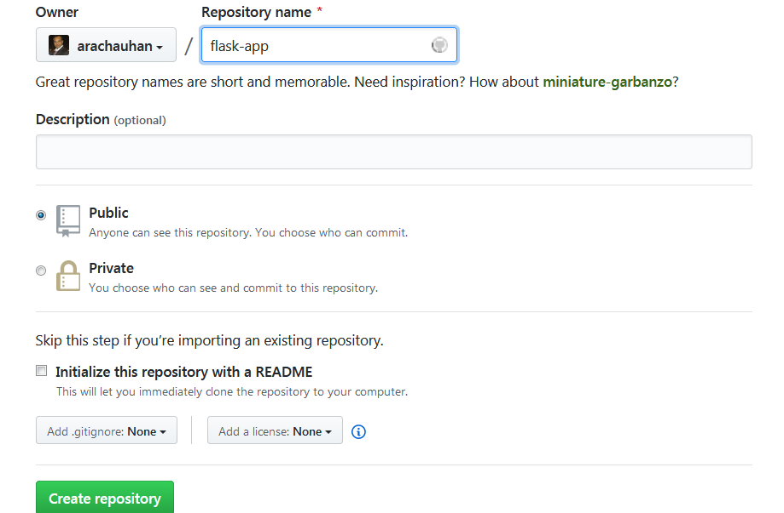
Create New GitHub Repository
Machine Learning Model Deployment
Copyright © www.ITbodhi.com

Slide 20
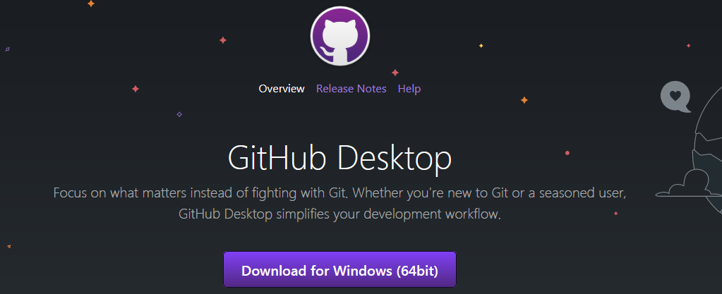
Using GitHUb Desktop for Rich Experience
Download and install it
We will be COMMIT complete project directory to GitHub and Connect Heroku to GitHub for WebApp deployment.
You can also use heroku git that uses command line to deploy models.
Machine Learning Model Deployment
Copyright © www.ITbodhi.com

Slide 21
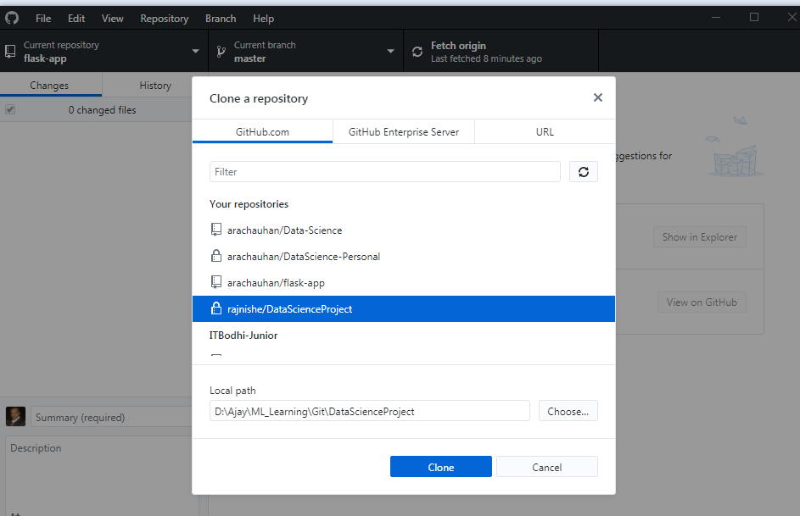
Clone GitHub repository to local project directory
Machine Learning Model Deployment
Copyright © www.ITbodhi.com

Slide 22
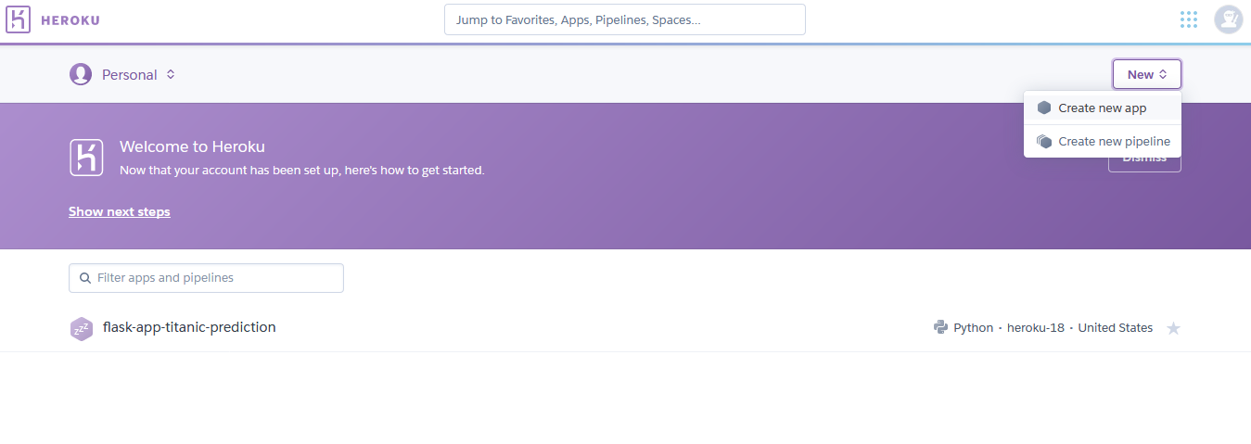
Create Fee account at www.heroku.com
Create a new app simply by choosing a name and clicking “create app”. This name doesn’t matter but it does have to be unique.
Machine Learning Model Deployment
Copyright © www.ITbodhi.com

Slide 23
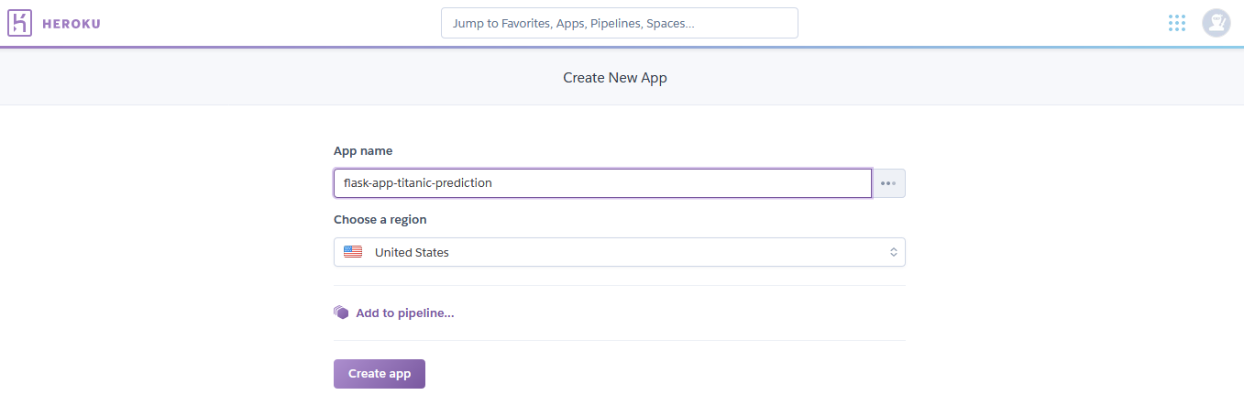
Create Fee account at www.heroku.com
Create a new app simply by choosing a name and clicking “create app”. This name doesn’t matter but it does have to be unique.
Machine Learning Model Deployment
Copyright © www.ITbodhi.com

Slide 24
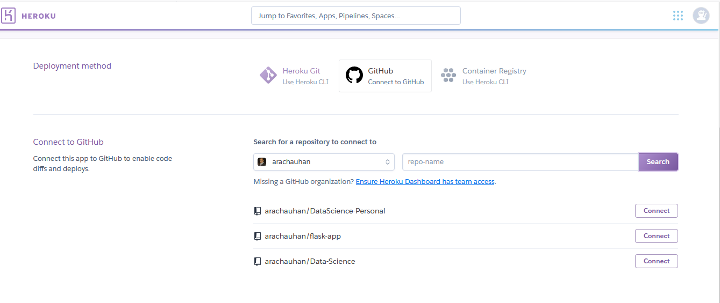
You have a few options for the way you can deploy the app.
Heroku CLI and GitHub
Select Github
Search repo-name as flask-app and connect
Machine Learning Model Deployment
Copyright © www.ITbodhi.com

Slide 25
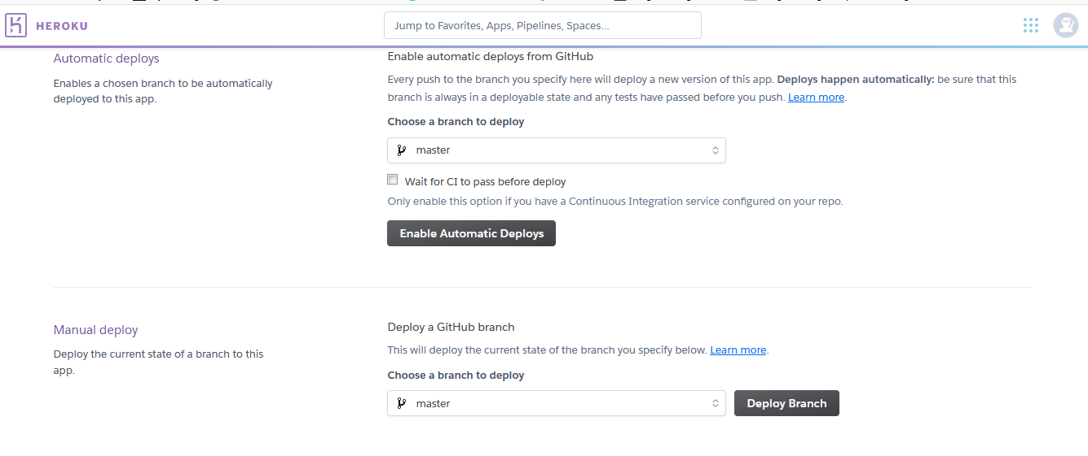
Just scroll to the bottom of the page and click “Deploy Branch”
Machine Learning Model Deployment
Copyright © www.ITbodhi.com

Slide 26
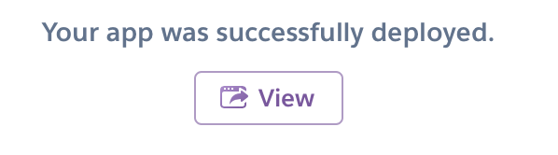
If everything Goes well, You should see below message
If something went wrong, check your requirements.txt, delete and dependencies that are giving you problems, and try again
Machine Learning Model Deployment
Copyright © www.ITbodhi.com

Slide 27
Deploying with Heroku CLI
In the Heroku CLI section, you will see these instructions to follow for deployment.
Paste each command into your terminal and follow any prompts like logging in.
Pay attention to any commands you will need to modify, such as cd my-project/ — where my-project/ should actually be your project directory.
The git remote should be set to the app name from Heroku EXACTLY.
Machine Learning Model Deployment
Copyright © www.ITbodhi.com

Slide 28
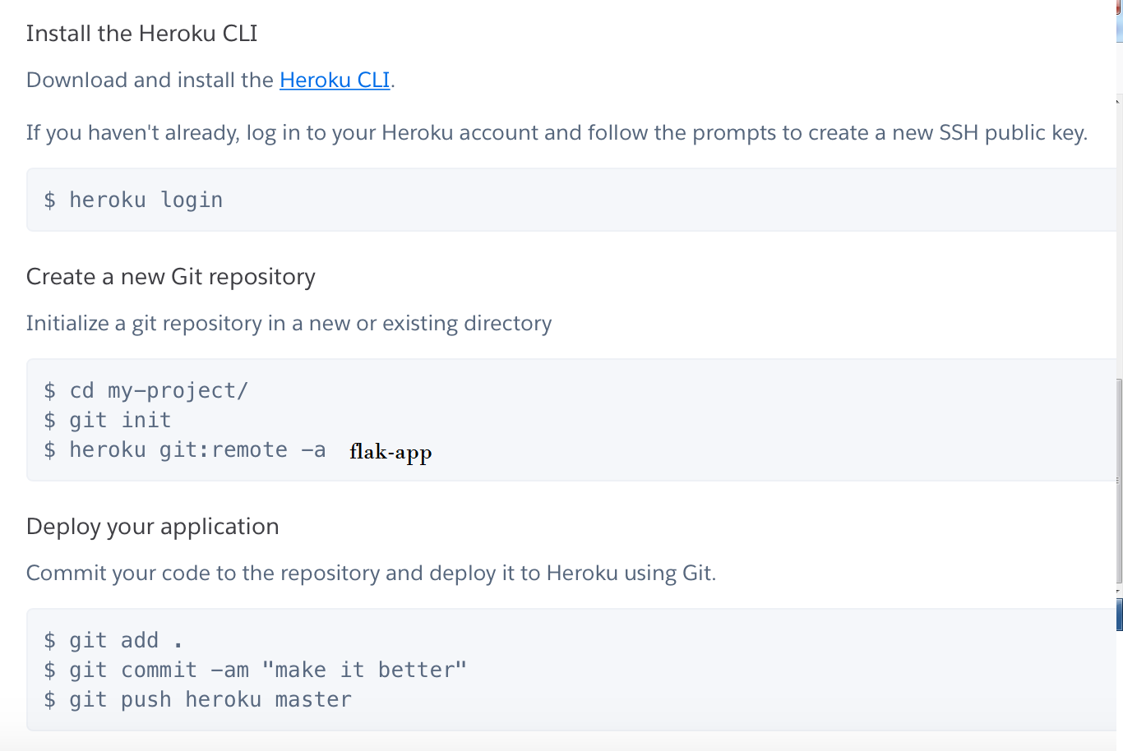
Machine Learning Model Deployment
Copyright © www.ITbodhi.com

Slide 29
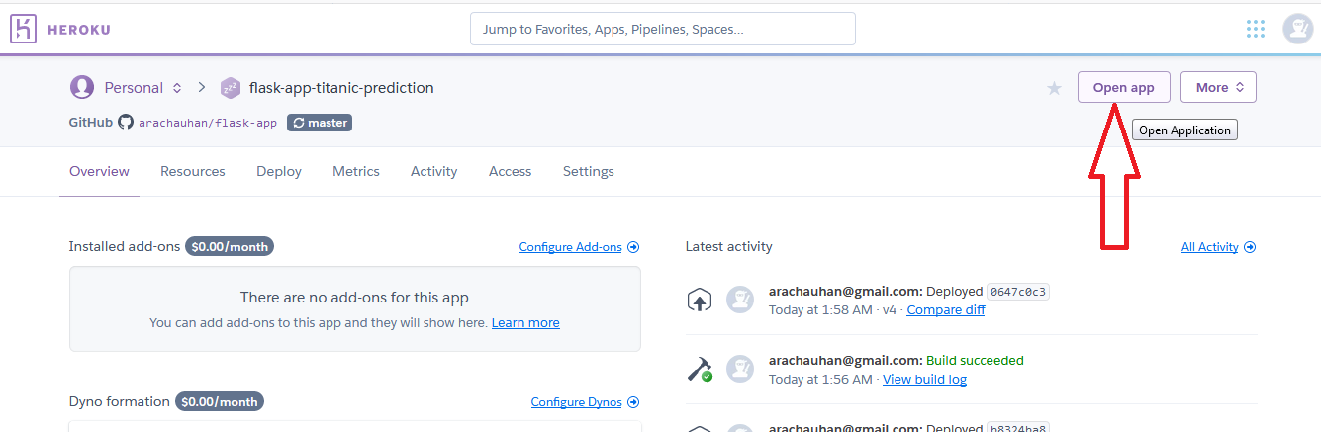
Test the Deployed Model & Generate Prediction
Click on Open App
Machine Learning Model Deployment
Copyright © www.ITbodhi.com

Slide 30
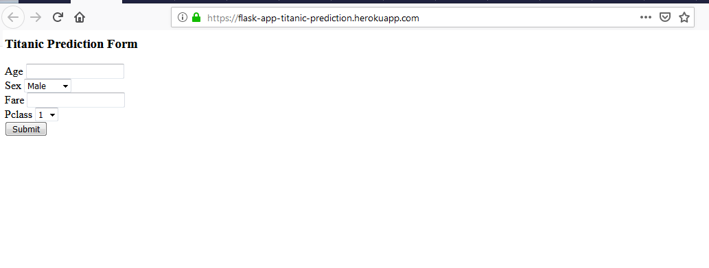
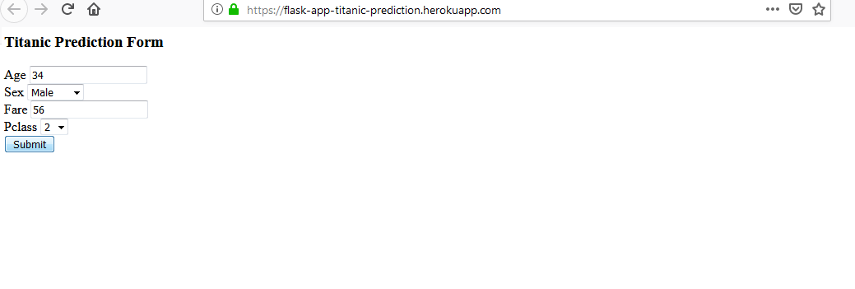
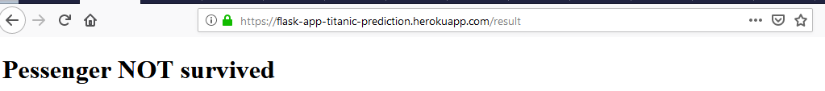
Machine Learning Model Deployment
Copyright © www.ITbodhi.com

